Slide 1
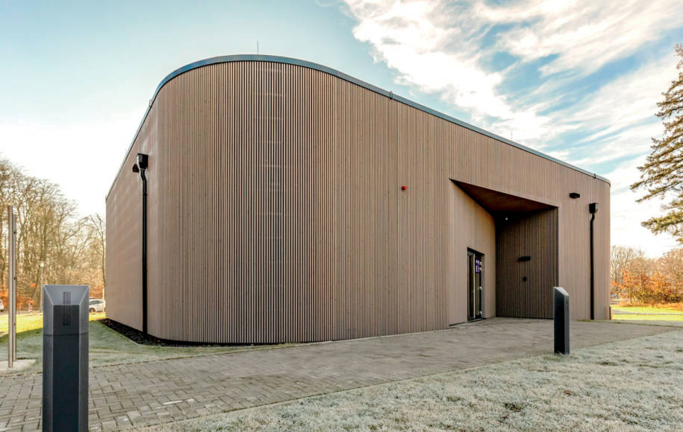
Quantum ANNEALING FOR SEMANTIC SEGMENTATION IN REMOTE SENSING: POTENTIAL AND LIMITATIONS
computerworld.ch
M2GARSS 2024 – Oral Presentation
April 16, 2024 Amer Delilbasic, Bertrand Le Saux, Morris Riedel, Kristel Michielsen, Gabriele Cavallaro

Slide 2
Driving questions
What is quantum annealing?
How can quantum annealing contribute to semantic segmentation of satellite images?
Which design guidelines should be followed?

Slide 3
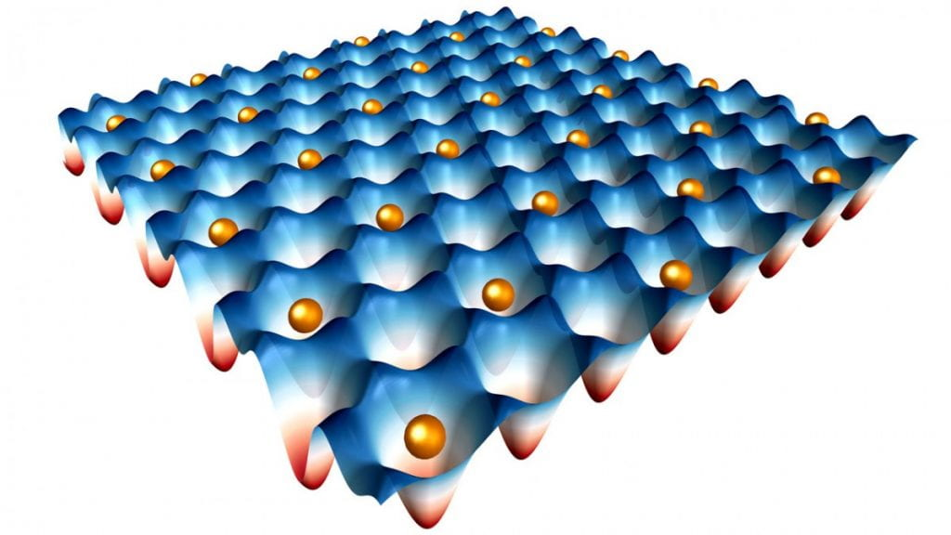
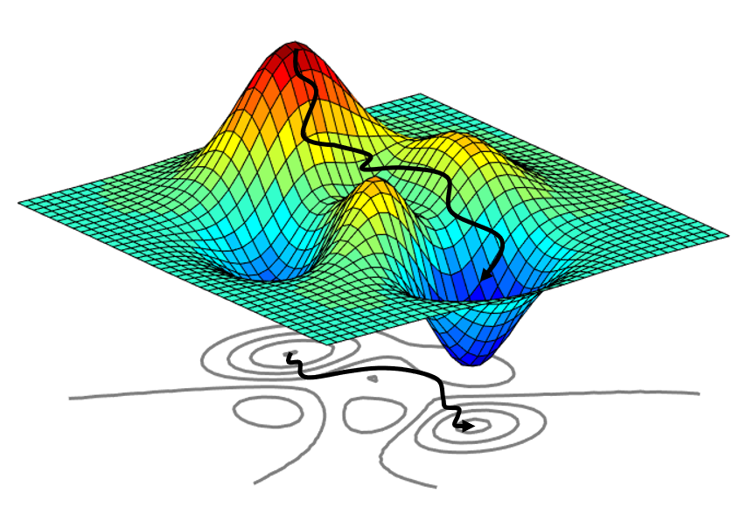
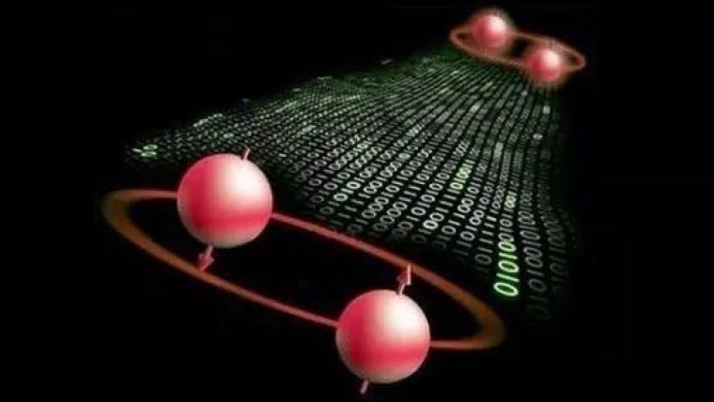
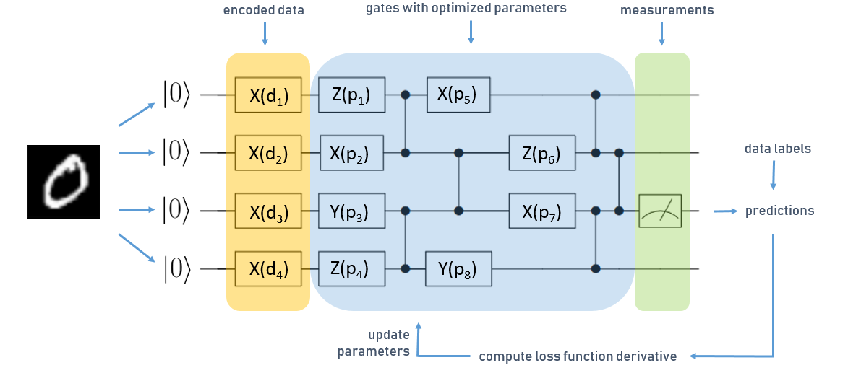
Main applications of quantum computing
Quantum annealing
Quantum simulation
Quantum optimization
https://quantum.cornell.edu/files/2021/11/quantum_simulation-1024x576.jpg
https://towardsdatascience.com/an-introduction-to-surrogate-optimization-intuition-illustration-case-study-and-the-code-5d9364aed51b
Quantum cryptography
Quantum machine learning
https://miro.medium.com/v2/resize:fit:760/0*ccRjnUb2QLCYTK5a.jpg
https://blog.tensorflow.org/2020/08/layerwise-learning-for-quantum-neural-networks.html

Slide 4
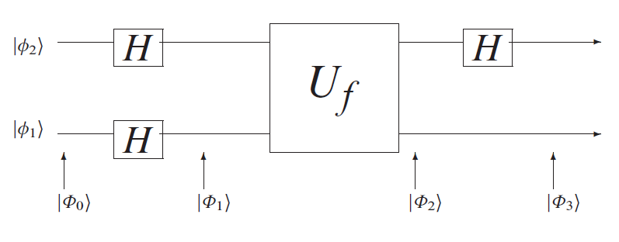
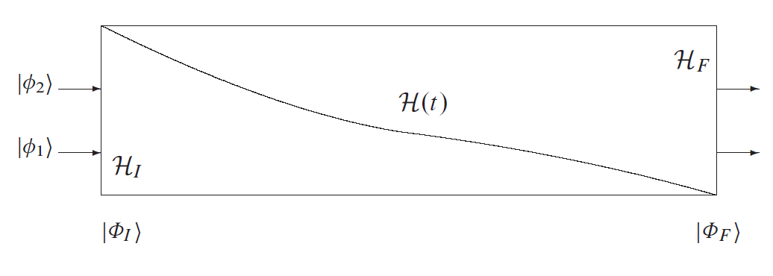

Quantum computational models
Quantum annealing
Quantum circuit model
Model where quantum gates and measurements are applied to qubits
Adiabatic quantum computation
Model where the time evolution of a quantum system under adiabatic conditions is described by the Hamiltonian $ℋ(t)$ and ruled by the Schrödinger’s equation
$$iℏ\frac{d}{dt}\left|Φ\left(t\right)\right\rangle =ℋ\left(t\right)|Φ\left(t\right)⟩$$
Catherine C. McGeoch, Adiabatic Quantum Computation and Quantum Annealing: Theory and Practice , Morgan & Claypool, 2014.
Catherine C. McGeoch, Adiabatic Quantum Computation and Quantum Annealing: Theory and Practice , Morgan & Claypool, 2014.

Slide 5
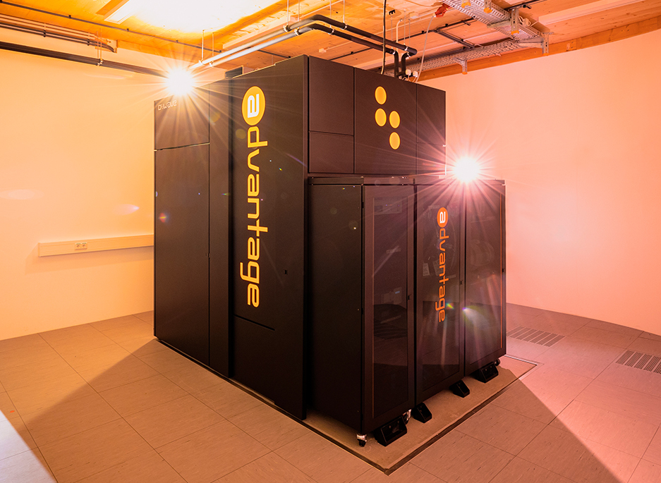
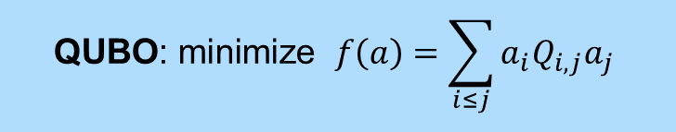
Quantum annealing for combinatorial optimization
D-Wave Advantage
Superconducting quantum annealer, 5000+ qubits, 35000+ couplers
Special case of adiabatic quantum computation
Heuristic search for solving specific combinatorial optimization problems, e.g., Quadratic Unconstrained Binary Optimization (QUBO)
Physical implementations offered by D-Wave Systems
$$\text{QUBO}\text{: }\text{minimize} f\left(a\right)=\sum_{i≤j}{a_{i}Q_{i,j}a_{j}}$$
https://www.fz-juelich.de/en/ias/jsc/systems/quantum-computing/juniq-facility
JUPSI, a D-Wave Advantage quantum annealer hosted at FZJ

Slide 6
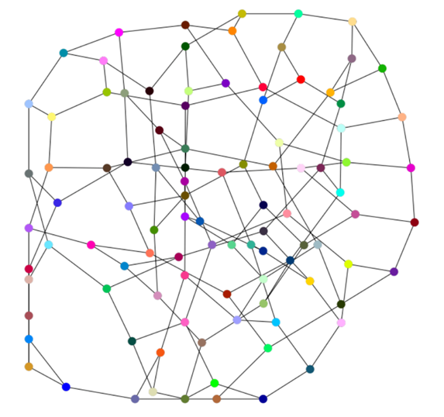
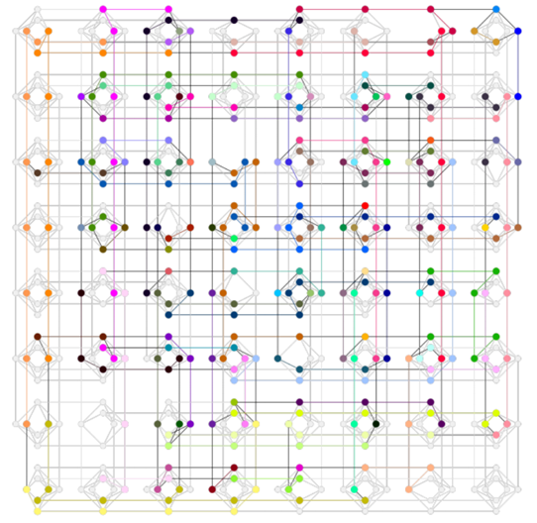
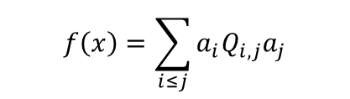
Embedding QUBO problems into a quantum annealer
solution
embedding
annealing
QUBO graph
Hardware graph
$$f\left(x\right)=\sum_{i≤j}{a_{i}Q_{i,j}a_{j}}$$

Slide 7
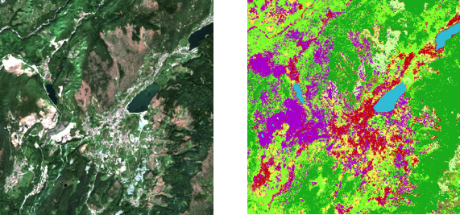
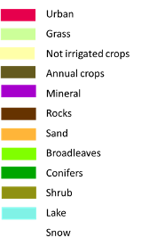
Applications of quantum annealing in Earth observation
Some examples:
SAR system design
Satellite acquisition planning
Feature selection
Semantic segmentation

Slide 8
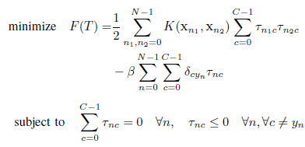
Quantum annealing for semantic segmentation?
Semantic segmentation literature is dominated by machine learning
How is a quantum optimization technique relevant?
Quantum Support Vector Machine
popular algorithm for classification and regression
Quadratic optimization problem!

Slide 9
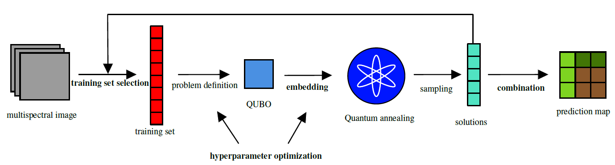
Quantum support vector machine general workflow

Slide 10

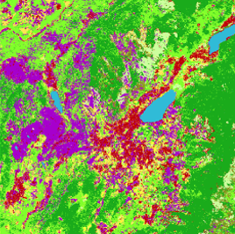
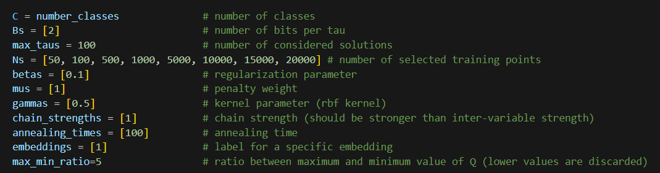
Techniques for quantum annealing
Training set selection
Problem embedding
?
?
Hyperparameter optimization
Solutions combination
?
?

Slide 11
Conclusions
Quantum annealing is a powerful but complex algorithm
It can already be tested today with quantum annealers
However, its physical implementation and limitations make it inconsistent
Several (classical) techniques can help to improve its performance

Slide 12
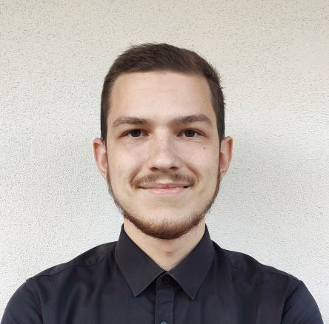
Questions?
Amer Delilbasic Doctoral Researcher @ Jülich Supercomputing Centre, Germany & University of Iceland
a.delilbasic@fz-juelich.de
linkedin.com/in/delilbasic

